Slide 1



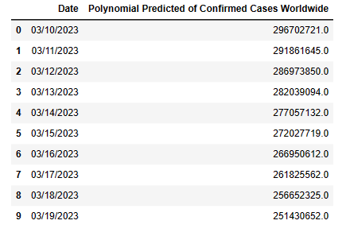

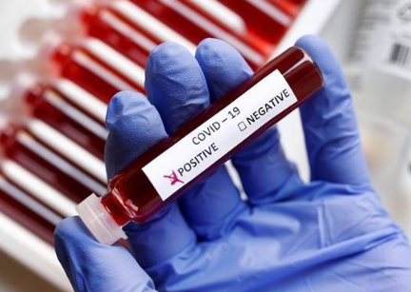
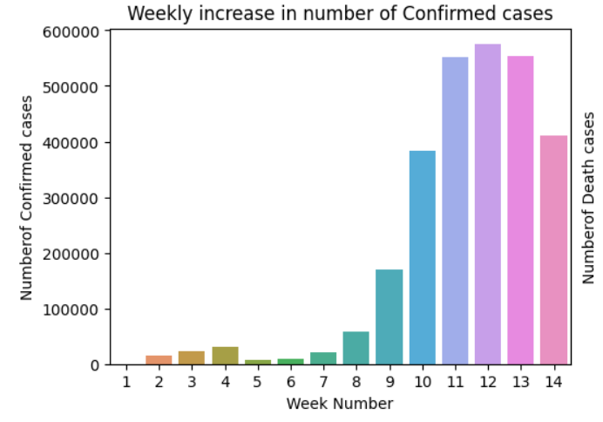
EARLY DETECTION OF COVID-19 USING MACHINE LEARNING TECHNIQUES
Department of Computer Science & Engineering
School of Computing
10214CS601– MINOR PROJECT-1
SUMMER SEMESTER 2023-2024
ABSTRACT
INTRODUCTION
RESULTS
STANDARDS AND POLICIES
Everyone is now dealing with the COVID 19 scenario, thus in order to take some security precautions, we must predict the virus. We are using machine learning techniques to forecast the virus. Based on symptoms, ML methods have been used to determine whether individuals have the virus. It could help increase the speed of disease identification, resulting in a reduced mortality rate. Analyzing the results obtained from experiments. The dataset is collected through GitHub and is frequently updated. Predictive methods can now be used to estimate the number of COVID-19 cases and deaths during the next two weeks.
This section describes the results achieved by running these ML models. First, we assessed the results by performing the algorithms of all the models. Using these values we found models worked the best in predicting the number of cases and deaths due to COVID-19. The results generated by the Regression and svm models are given best accuracy. we used the best models to predict the number of COVID-19 cases and deaths caused due to it for the coming month.
Google Colab, short for Colaboratory, is a cloud-based platform provided by Google that offers a similar environment to Jupyter Notebooks. While Anaconda provides an environment on your
local machine, Google Colab allows users to run Jupyter notebooks directly in the cloud, comes with pre-installed libraries and supports popular machine learning frameworks like TensorFlow and
PyTorch. Users can collaborate in real-time and leverage Google’s powerful hardware, including GPUs, for accelerated computation. Google Colab also integrates seamlessly with Google Drive, making it
convenient for data storage and shring.
Standard Used: ISO/IEC 270019
COVID-19, a new coronavirus, caused an epidemic in Wuhan, China, in December 2019. Itquickly expanded to over 200 nations throughout the world following its inception. The number of verified corona virus infected patients is expanding at an exponential rate throughout the world.It has infected over 17 million individuals to far, with over 0.7 million people are dying as a result.It’s critical to develop a technological tool that can estimate the number of infected individuals and forecast the worst-case situations.The tests that measure the coronavirus to determine the presence of illness are to be examined more since the range of symptoms of positive cases has been rising. As corona virus has achieved pandemic status and the number of patients continues to rise at an exponential pace is critical in determining and controlling the spread of this rapidly spreading illness. The goal of this study is to create a model that predicts the number of confirmed,deaths and recovery cases caused by corona virus through out the world based on data from several countries.
Table 1. prediction of covid-19.
Figure 1. Label in 20pt Calibri.
Figure 2. Label in 20pt Calibri.
CONCLUSIONS
METHODOLOGIES
In this current pandemic situation, the whole world public is starving for data to get tips to protect individuals from this COVID-19 virus. To analyze and summarize covid19 dataset pandemic the data frames can be used. To predict the analysis and time series for the next coming month using ARIMA model . The results show that Pandemic analyzer will give accurate information about virus which gives better performance to implement machine learning techniques on the dataset.
TEAM MEMBER DETAILS
Past data are used to train the model, and then this trained model is used to test new data and then for prediction. The trained ML model's performance is evaluated using some portion of available past data (which is not present during training). This is usually referred as the validation process. In this process, the ML model is evaluated for its performance measure, such as accuracy.
<Student 1. vtu20205/G.Ushaswi>
<Student 2 .vtu20215/P.Lokesh Kumar>
<Student 3 .vtu19287/M.Harshitha>
<Student 1. 9494703322>
<Student 2. 7842727434>
<Student 3. 9390034937>
<Student 1. vtu20205@veltech.edu.in>
<Student 2. vtu20215@veltech.edu.in >
<Student 3. vtu19287@veltech.edu.in >
ACKNOWLEDGEMENT
Project Supervisor: Dr.K.Antony Kumar/Assistant professor
Project supervisor Contact No: 9840644980
Project supervisor Mail ID: antonykumar@veltech.edu.in
Chart 1. Weekly iconfirmed cases

